Slide 1
Machine Learning Foundations: Applied Probability
Alok Singh
Principal Engineer

Slide 2
Probabilities must be regarded as analogous to the measurement of physical magnitudes; that is to say, they can never be known exactly, but only within certain approximation. Émile Borel — Probabilities and Life

Slide 3
Probability Topics :
Random Variable
Properties (Sum and Product)
Common Distribution
Summary Statistics
Exponential Family
Transformation
Bayes Theorem
Sufficient Statistics
Inner Product
ML Tricks
ML Apps
Notes:
Explain each of the component.
TBD: add tricks and apps

Slide 4
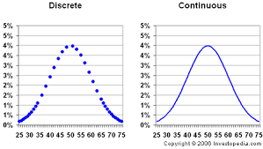
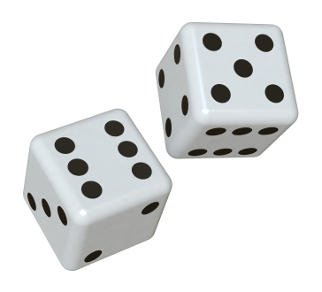
Section: Random Variables and Probability

Slide 5

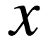

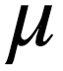



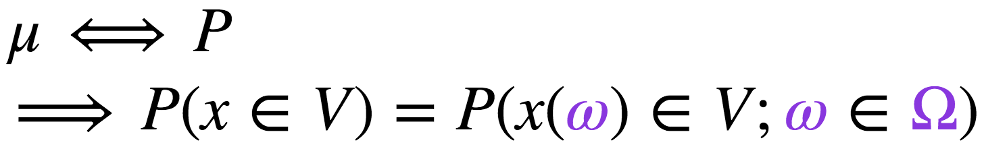
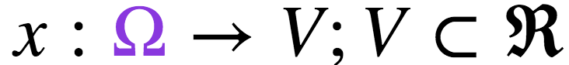
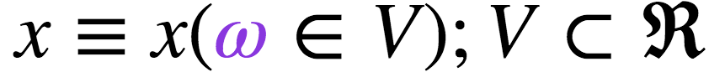
Reality, Random Variable and Probability
Random Variable
Probability
State Space
Mapping
Measurement
An Experiment
HH
# of heads
0.25
H
2
H
T
HT
1
0.5
T
H
TH
T
TT
0
0.25
Notes:
Explain Animation:
An experiment creates all possibilities but then we do the frequency stats to find that the best way to defined the RV
How random variable is not really random but is a function
Concept of measurement space. And how probability relates to it.
Why this way of thinking is more important for the future conversations.

Slide 6
Joint, Marginal and Conditional Measurement
x1
x2
x3
x4
x5
x6
y1
y1
Row Sum
y2
y2
Column Sum
Select Col x5
x1
x2
x3
x4
x5
x6
y1
y2
Notes:
Explain Animation:
We can have more than one random variables. Which might interact with each others. Ideally if we have two different random variables say for examples for box containing blue and red ball. We can
Especify them using the joint distribution
Extension of the previous experiments.
Rv 1 is coin toss y
Rv 2 is dice rolling x
We will get the frequency table
If we are interested in only in y1. We can add all the rows since the other information doesn’t matter
If we are interested in only in x. We can add all the columns
Lets say we don’t see the whole events but say if the dice is 5 i.e x5 what is the frequency measurement for coin i.e y1
First two cases are called marginal measurement
And last one called the conditional measurement

Slide 7
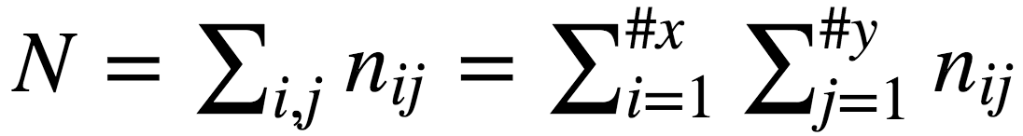
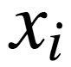
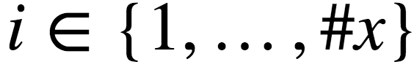
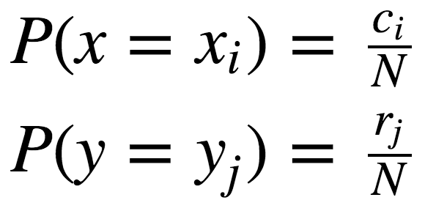
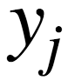

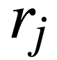
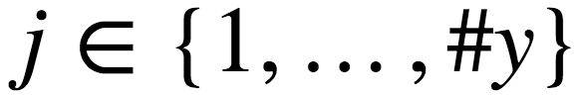
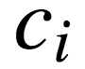
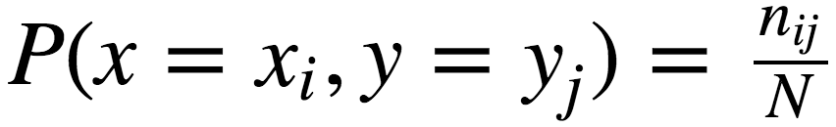
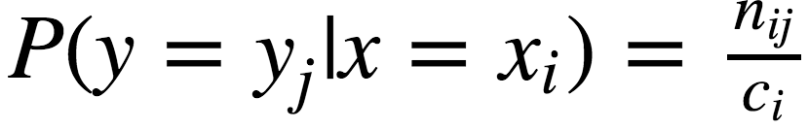
Joint, Marginal and Conditional Probability
Marginal P(x) and P(y)
Joint P(x,y)
Conditional P(y|x=xi)
Notes:
Explain Animation:
1 & 2) Lets rv x has cadanility #x and rv y has cardanility #y
3) We will create the rectangular grid as before
4) Let each box contains the number of samples nij
5) We can sum over each row indexed by j corresponding to each yj to get rj
6) Similarly we can sum over each col indexed by I corresponding to each xi to get ci.
7) Lets formalize it. Since it is more convenient to normalize the measurement in the range of 0 to 1 so that we can convert it into probability.
We will divide every measurement with the total sample size which is just the sum of each of the boxes.
8) Once we have these information, we can always find the marginal probability as the normalized measurement as talked in previous slides. Note
that marginal xi measurement is just the sum of ith columns and marginal yj is the sum of jth row
9) Similarly the the joint probability for each of the co-ordinate is represented by measurement corresponding to each box and is given by the normalized frequency
10) For the conditional probability the total sample size is not N but is conditioned on the given random variable . i.e if we already know that x = xi then we have to only consider the total sample space corresponding to xi which is ci and we can normalized the frequency of y with this ci

Slide 8
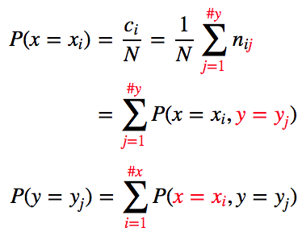
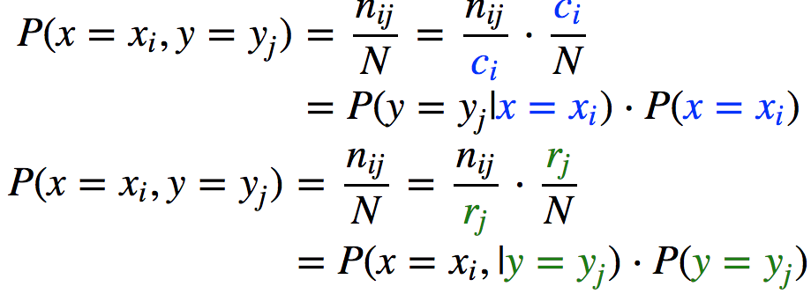
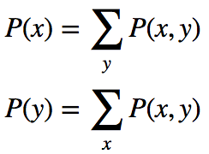
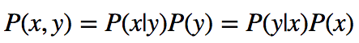
Useful Rules: Sum and Product
Probability of each sample in terms of Joint Probability
Joint Probability in terms of Conditional Probability
Sum Rule
Product Rule
Notes:
Explain Animation:
1) From previous slides we notice that actual calculation of marginal just involves summing out the unwanted variables. Visual summing is equivalent to summing the unwanted variables algebraically as algebra is easier than visual approach for writing programs
2) Lets consider probability of xi sample which is just the ratio of col sum of ith col divided by N but I’th col sum can be represented as summing everything in blue arrow and which in turn is the join probability for samples in the I,j box.
Similar argument applies to yi samples
3) Now since the above rule is true for each of the xi and yj , we can compactly write them as follows. Note that sum rule is just the marginilization
4) Lets look at the joint probability for the I,j sample i.e (xi, yj) which is just the ratio of nij/N but we do some algebraic manipulation by multiplying and dividing by I’th col sum and we notice the first term is the conditional distribution and second is the marginal probability. Thus we can express the joint distribution as the product of conditional and marginal probailities.
5) Here also this is true for all the samples and hence we can compactly write them as …

Slide 9
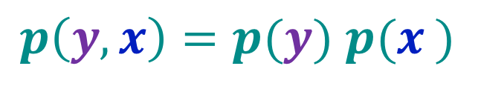
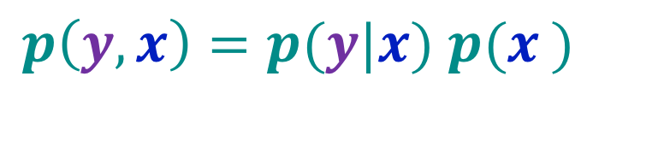
Independent Random Variables
$p\left(y, x\right)=p(y|x)$ $p(x_{ })$
$p\left(y, x\right)=p(y)$ $p(x_{ })$

Slide 10
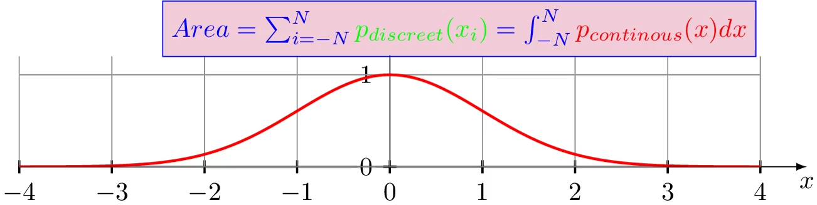
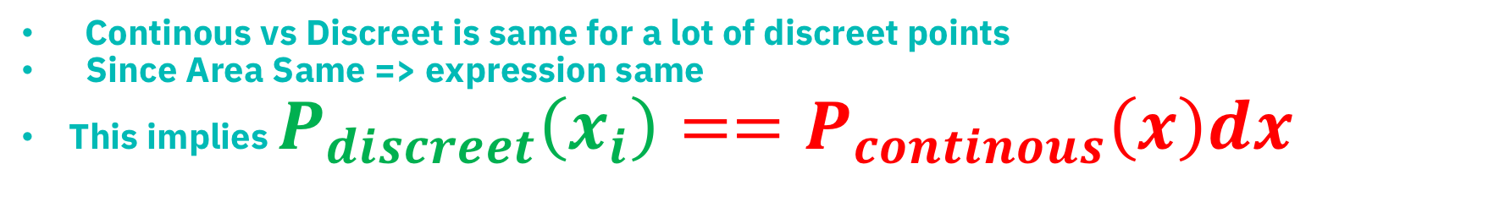
Continuous Probability.
Continous vs Discreet is same for a lot of discreet points
Since Area Same => expression same
This implies $P_{discreet}\left(x_{i}\right)==P_{continous}\left(x\right)dx$
Notes:
A) Since any continuous curve can be represented as the combination of multiples rectangles.
B) Since whether you consider the area under the red curve or the sum of all the blue rectangles they are same and hence the expression in green and red must be same.
C) meaning all the knowledge for the discreet case can be applied to the continuous case, as long as we replace discreet version with the proper continouse version i.e p(xi) for discreet == p(x)dx for continuous case
D) All our reasoning holds true for the continuous case too

Slide 11
Random Variable, Probability summary
Thus we saw that to model the random ness of a variable. We map it to a function from sample space to the subset of real line.
We have considered probability as the frequency count measurement. But there is another way of thinking about it i.e it can be our belief system even thought we have not performed any measurement. Example is the sampling of democrats vs republican.
We normalize the probability for convenience and also we can perform various algebra on the probability of various random variables.
Notes:
Lets say we perform some experiments like flipping a coin or rolling a dice or just counting the number of cars crossing a particular intersections.
There will be some variat

Slide 12

Section: Characterizing Distributions and other Representations

Slide 13
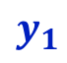
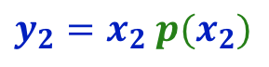
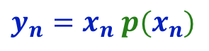
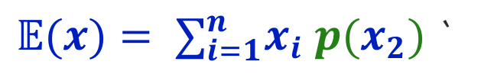
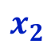
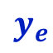
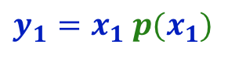
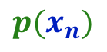
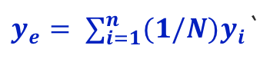
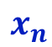
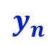
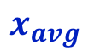
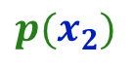
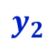
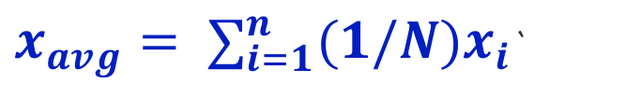
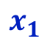
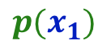
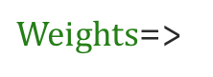
Averaging to Weighted Average (Informal Expectation)
$$x_{1}$$
$$x_{2}$$
$$x_{avg}$$
$$x_{n}$$
$x_{avg}= ∑_{i=1}^{n}{(1/N)x}_{i}$`
$$y_{1}$$
$$y_{n}$$
$$y_{2}$$
$$y_{e}$$
$Weights$=>
$${p(x}_{1})$$
$${p(x}_{n})$$
$${p(x}_{2})$$
$${y_{1}=x}_{1} {p(x}_{1})$$
$${y_{2}=x}_{2} {p(x}_{2})$$
$y_{e}= ∑_{i=1}^{n}{(1/N)y}_{i}$`
$${y_{n}=x}_{n} {p(x}_{n})$$
$𝔼(x)= ∑_{i=1}^{n}x_{i}$ ${p(x}_{2})$`
Notes:
-rain drop on a broken roof top

Slide 14
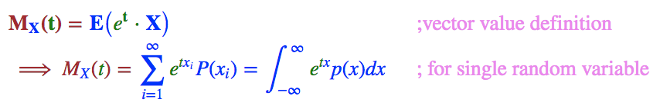
Characterizing Probability Using Moments
. So we saw probability can be seen as the lookup table, which can easily become unmanageable .
. So we like to parameterize most of the distribution so that we have to only remember the those parameters.
. Not all distribution can be parameterized and many times there is no closed form expression and hence like to get information about the distribution using it’s moments
. Since it is mathematically convenient to use this forms, we will explore this more.

Slide 15
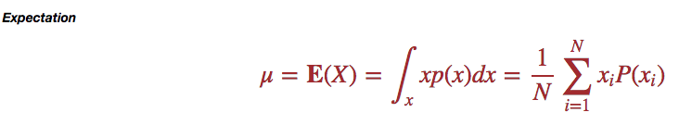
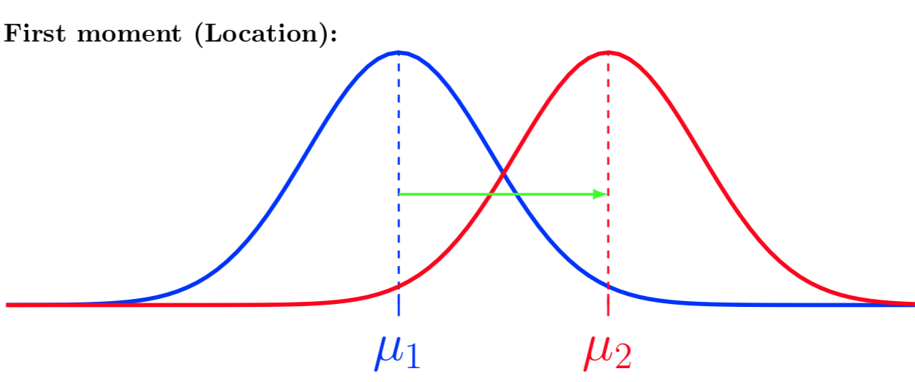
Characterizing Probability (Expectation)
. First order moment is called expected and intuitively gives us a way to approximate complex distribution with a single point.

Slide 16
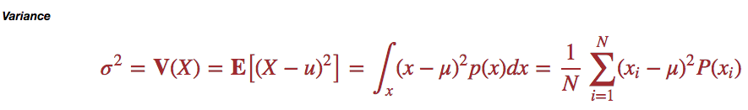
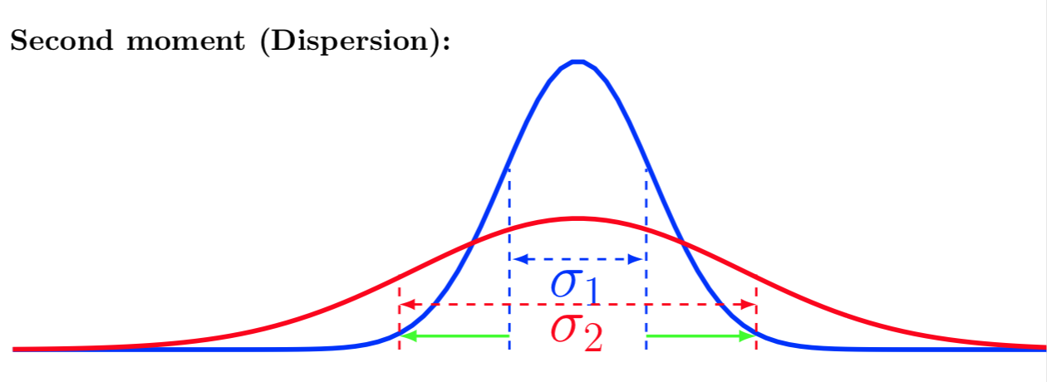
Characterizing Probability (Variance)
. Many distribution is not a single point but spread around the most likely value and second moments gives us the way to measure the spread.

Slide 17
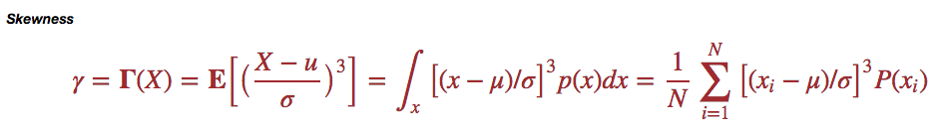
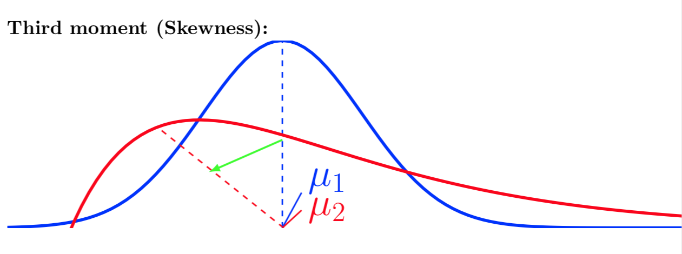
Characterizing Probability (Skewness)
. We can have 3rd moment representing skewness and gives us the information whether PDF is left sided or right sided.

Slide 18


Characterizing Probability (Kurtosis)
. 4th moment called kurtosis representing heavy tails or outliers.

Slide 19





Characterizing Probability (Covariance)
. If we have two random variables $X_{1}$ and $X_{2}$, we would like to know they they behave together in terms of variance.
. We can define covariance to measure this.
. The idea can be extended for the vector of random variables $X=\left(X_{1, }X_{2, …, }X_{n}\right)$.

Slide 20



Characterizing Probability (Covariance as Inner Product)
How do we measure the similarity between these two vectors?
.Since covariance matrix between two vectors of random variables (i.e $X$and $Y$) gives us information about similarity between them
.Note that in general inner product gives us the similarity between two vectors.
.Hence intuitively inner product and covariance represents the same idea and hence this formulation makes a lot of sense for mathematical convenience.
. Covariance Matrix characterizes the vector of random variables:
$X=\left(X_{1, }X_{2, …, }X_{n}\right)$.
.What if, we have two different vector of random variable :
$$X=\left(X_{1, }X_{2, …, }X_{n}\right)$$
$$Y=\left(Y_{1, }Y_{2, …, }Y_{n}\right)$$
$$<X,Y>=Cov(X,Y)$$
Similarity between two vectors of Random Variables

Slide 21



Graphical Representation of Joint Distributions
. We could have many random variables, drawn from different distribution.
. In many instances, we would like to have the holistic global picture by creating a model which presents the joint probability distribution.
. We have seen that joint probability can be represented by CPD.
. We can extends this issue to visualize the joint probability as the graph.
. There are many advantages of this approach , which we will cover in separate sub-modules.
. In short, we need much less number of parameters to represent the joint distribution
. We can use conditional independence
. We can model and change our graph in light of new evidences.
$$x_{}$$
$$y_{}$$
$$P(y|x)$$
Notes:
From previous slides we have established that we can write joint distribution as product of cpds
Note that node having arrow in represents conditional pdf given parent
Total joint distribution is product of all the nodes pdf
There are many advances of using graphical representation, which we will use in future.

Slide 22











Graphical Representation of Joint Distributions (Many interacting Random Variables)
$$x_{t1}$$
$$x_{t2}$$
$$x_{stock_buyback}$$
$$x_{product_news}$$
$$x_{technical_analysis}$$
$$x_{quarterly_report}$$
$$x_{positive_sentiment}$$
$$x_{PE}$$
$$x_{stock_movement}$$
$$x_{fundamentals}$$
$$x_{debt_ratio}$$
Notes:
1) If we would like to model stock price movements using a set of conditional probability distribution
2) It could conditionally depend on many random variables variables for example fundamentals
3) Positive/negative sentiments
4) Technical aspects
Note that to find joint distribution we just multiply pdf of each node and the node that has arrow coming in has conditional probability distribution
5) Each of them may again conditionally depends on other rv for examples fundaments can be dependent on two other rv
6) Similarly for sentiments
7) And for technical analsysis

Slide 23






Parametric Distributions
. Since many distributions have many similarity in terms of it’s moments and other characteristics.
. Note that similarity doesn’t mean equal. By Similarity, we means there shape is similar (for example various bell curve looks same but can differ on spread and location of maximum).
. Since these various distribution is similar but differs on key parameters (in the case of bell curve, location of maximum and spread), we should be able to characterize those family of distribution based on $parameter vector$ $θ$
. In short, we are indexing the PDF, by $parameter vector$ $θ$ by and we called these family of distribution as parametric distribution
$θ$
$$𝓟=\{$$
$$P_{θ} |$$
$$\}$$
$$∈Θ$$

Slide 24









Sufficient Statistics for parametric Distributions
. For the parametric PDF, we collect many samples (say N) $x$ and estimate it’s $parameter vector$ $θ$ Which characterizes parametric PDF.
. However N can be very large and we don’t want to keep all the N samples while downstream team compute the parameter.
$$x_{}$$
$$θ_{}$$
$${T(x)}_{}$$
. $Sufficient Statistics T(x)$means what is essential in a data set, implying that other things can be thrown away.
. Hence $Sufficient Statistics ,$depends on dataset N samples but once computed it is significantly smaller in size.
.Data collection team can compute sufficient statistics for downstream team and don’t have to pass around large actual dataset.
$$P(x)$$
$$P(T(x)|x)$$
$$P(θ|T(x))$$
. Given $Sufficient Statistics, T(x)$, we can calculate $parameter vector,$ $θ$ without the need for large N samples, $x$
.Formally,
$θ$ independent of $x$ given $T(x)$
Notes:
Relation between x and theta
Explain graphically dependence on x and theta
Text of suff stats
Graphical how T(x) depends on x
We can view those random variable as PDF
Connection between T(x) and theta
Grahically 6

Slide 25

Section: Bayes Theorem

Slide 26




Bayes Theorem
$$x_{n}$$
$$y_{n+1}$$
Posterier
Evidence
Prior
Iterative Bayes Theorem
normalization
Notes:
From previous slides we can rewrite joint distribution using two form of conditional statements
If we consider y as the some kind of inference we can see there is the connection between our inference and our data likelihood
Prior or Knowledge so far
Evidence or likelihood
Posterier
8)
We can iteraively apply Bayes theorem. Graphically representing the y and x and the conditional dependent graph. We will talk about it later more
We can see that we can represent bayes theorem in a graphical model and usually we collect data and we iteratively refine our knowledge and just bayes theorem can be very handy for a lot of applications to solidify our intuition ile prior as we get more evidence or data.

Slide 27

Bayes Rule: Illustration using biased coin
.We want to estimate the empirical probability with some confidence using the bayes update
. Since We don’t know about the probability, we assume that we have a random variable representing the probability. Beta distribution is one of such distribution of distribution and we use it to model the probability of a biased coin
Notes:
Explain Animation:
Why is Bayes theorem so important? Since it allows us to modify our degree of belief to the as we get more evidence.
Lets assume that we are given a unfair coin so that it likely to land on head more often. Lets quantify it to be 0.7 the probability of head by vertical red line.
Since we don’t know the p(H) of unfair coin is 0.7, we will experiment it and see the evidence. At each evidence we will update our belief.
Since we don’t know what is the best belief system lets assume that we can get any range of p(H) to be triangular
We keep tossing coin and update our belief.
How do we know that we have collected enough samples?
We will stop when the variance start to tapper.
In the middle of simulation, we can see that we are far more confident that we are converging to some range that’s one of apps . We will see more of the bayes theorem apps in the actual ML sections.

Slide 28

Section: Entropy
$H\left(x\right)=−Σp\left(x_{i}\right)\log_{2}$($p(x_{i})$)

Slide 29
Entropy
>= 2
. I am thinking about a number between 0 to 3 (both inclusive) and I would like you to guess it.
. You can only ask question whose answer can be yes or no.
. We enumerate all the yes/no questions forming a binary tree and leafs of the tree
represent all the possible states i.e the number I am thinking.
. Note that we need maximum of 2 yes/no question to find the number
. For mathematical convenience we want entropy to be always positive and zero when there is no surprise.
. Entropy is the positive measure of surprise
>= 1
>= 3
0
1
2
3
${Total information=Entropy= Log}_{2}$(Num_States)
${Entropy_this_example= Log}_{2}$(4) = 2
Notes:
It means we can express the content from 0 to 3 thus using 2 bits of information

Slide 30




Entropy and Probability connection.
. Since Total entropy gives us the number of bits required to encode whole sample space.
.But in real life, only part of the sample space are encountered and we need some way to measure the information content of one piece of data.
. Now if a number 3 is generated how much information it gives us?
. Since here proportion is ¼ and we take log2. we get -2.0 (we will deal with negative sign later)
$$Information for one data point x_{i}=I(x_{i})$$
$I(x_{i}$) $=−\log_{2}(P(x_{i}))$
. Note that the information contained in the one data point is same as the total information since all the samples are equally likely.
. In probability all samples need not be equally likely. And hence we take the expected value of the information contained in each data point
. Also since by definition, entropy has to be positive and we know that probability is always between 0 and 1 , and log will always be negative and hence we can add negative sign to the average information i.e entropy
$$Entropy(H)=Expected Value of Information$$
$H=$ $E_{}^{}[{I(x}_{i})]$
$H=$ $Σ_{1}^{N}P(x_{i}){I(x}_{i})$
$H=$ ${−Σ}_{1}^{N}P(x_{i})\log_{2}{(P(x}_{i}))$

Slide 31


Entropy some properties and applications.
. Since entropy maps many points i.e many point probability to one number . Entropy becomes very useful for estimating the whole system with one number rather than many many information about probability about each points.
. Symmetricity: $H\left(s1, s2\right)=H\left(s2,s1\right)$
. Additivity: $H\left(s1,s2,s3\right)=H\left(s1,s2\right)+H(s3)$
. This is used a lot in ML . In our tutorials , we will use it in decision tree and random forest.
. Since it measure surprise. Surprise should be zero for certain and uncertain events and also it must be maximum for equally likely events.
By Brona and Alessio DamatoNewer
https://commons.wikimedia.org/w/index.php?curid=1984868

Slide 32
Entropy Some Corner cases.
Zero Entropy
Non-Zero Entropy
Notes:
Since black rectangle all pixels are zero so there is no surprise
Similarly white rectangle all pixels are 1 and hence there is no surprise
Here is a shaded gradient blue and we can predict pixel 100% so there is surprise and hence non zero entropy

Slide 33

Using Entropy to compare PDF (KL Divergence).
. In Many applications, we would like to approximate one complicated PDF with the known and analytical PDF.
. For approximation, we would need some way to define the difference between two PDF [i.e p(x) and q(x)] so that we can minimize the difference between two PDF.
. Since entropy is a functional on PDF which encodes it to one real number.
. We can compare the difference between two entropies.
. Since difference of entropies is actually difference of information content of each of the possible variables. We can use the difference in information content to compare two PDF
. However final expectation is taken over the baseline PDF i.e p(x).
. This difference is called KL-Divergence.

Slide 34

KL Divergence Illustration
. KL Divergence between two PDF p(x) and q(x).
. KL divergence is always positive and zero when two PDF are same and increase rapidly for differences.

Slide 35

Section: Common Distributions => Gaussian Distribution

Slide 36
Gaussian Distribution How it arises?
. Lets do one thought experiments. There is a party and there are around 200 drunk people.
. Each of them decide to toss a coin and on head they go left one steps and on tail they go right one steps.
. Each of them repeated the coin toss for 200 times.
. We don’t care about individual but as a group where does everyone ends up?
. We can simulate it and plot the final and intermediate location of each of the person.
. X axis denote the time and Y axis denotes the location in 1D.

Slide 37

Gaussian Distribution from the common Random Walk
. Every one is clustered around origin i.e 0 why?
. There is some variance of their spread and why is it contained?
. Why this phenomenon i.e. Stochactic Process is important?

Slide 38

Multidimensional Gaussian Distribution.
. We could have more co-related variables i.e height and weight of person etc and this gives rise to multidimensional Gaussian distribution

Slide 39
Gaussian Distribution Properties (TBD visuals for translation, sum and product)
. Conditional are also Gaussian (note projection on vertical planes
. Since Marginal can be computed using summation of all the conditional that will be also be Gaussian since linear Combination is also Gaussian.
. Iso Countours gives us same probabilities and are ellipses.
. Translation results in Gaussian Distributions.
. Sum of two Gaussian is Gaussian.
. Product of two Gaussian is Gaussian.

Slide 40
Gaussian Distribution Properties (Equations TBD)
. TBD
Similar as previous slides but in equation formats

Slide 41
Gaussian Distribution Properties Application.
. Since Gaussian distribution is the maximum entropy distribution with given mean and variance.
. If we know these two parameters, we can assume the distribution to be approximately Gaussian and can make our computation. We won’t go wrong.
. Inferencing or causality and other things involves conditioning and marginalizing and we saw it is very convenient to do those operation just making it a good choice for computational efficiency.
. We can create joint distribution much more easily
. Since it is parametric distribution, we only need to remember a set of parameters to describe the whole model

Slide 42

Section : Exponential Family of Distributions

Slide 43


Exponential Family
Notes:
Any distribution of the form this is very important for many of the ML and AI applications and hence we must study them
The main part is the a n variables random variable is determined by the shape function and the exponential part is the pair wise i.e dot product of sufficient statistics and natural parameters
Natural parameter could be just the normal parameters but it make sure that the dim are the same to perform dot product
Z is the partition or normalization function.

Slide 44
Exponential Family (Examples…)
Name | Equation(TBD) | Sample plot (TBD)
Gaussian
Bernoulli
Binomial
Multinomial
Exponential
Poisson
Beta and Dirichlet
.

Slide 45
Exponential Family’s Convexity (Why it matters…)
.They are convex meaning one can perform numerical computation wrt finding maximum or minimum robustly and efficiently. E.g Gaussian distribution is convex.
. Convexity is another way of saying a set member can be represented as combination of other members .(Why it is important?)
. Convexity guarantee that there is only one maximum of minimum. Since any of the example distribution
Non-Convex Shapes
Convex Shapes
Notes:
1) Explain why as numerical process can move on

Slide 46





Conjugacy and Combining multiple Exponential Family.
.Since we can represent the joint distribution as the product of many CPD
. Also we can represent more complex graphical model using the CPD and chain.
. Above two means that if we have to calculate the joint distribution we have to multiply them and convenient property of product of exponential is just the sum of exponent allows us to write the model as the joint exponential distribution and thus allows us to perform computation more efficiently.
. The related concept is the concept of conjugacy is that is we choose to model complex model and our belief need to be encoded the best from the principle of maximum entropy is to use relevant conjugate prior belonging to same family.
$$θ_{1}$$
$$x_{1}$$
$\sim exponential_family(θ_{1}, x_{1}, x_{2}$, $x_{3}$)
$$x_{3}$$
$$x_{2}$$
Notes:
1) Explain why as numerical process can move on

Slide 47
Applications
. We can build network
. We can maximize the probability if we decide to work with exponential distribution.
. We can do hypothesis testing.
. We can approximate, the complex distribution using the mixture models.
. For intractable distribution, we can do sampling techniques to find it’s value.

Slide 48
Section: Probability Tricks for ML and Cautions…

Slide 49

Log Trick
.As we will see usually joint PDF involves multiplication of many CPD or independent PDF.
.Numerically it is much easier to work with sum than the product terms
. And hence in many instances we would like to convert the joint PDF which can be represented as the multiplication of CPD to some form of sum of function of CPD.
. However doing that operation should change the relative value of probability .
. One such transformation is log transformation as It is
Monotonous increasing function
Converts product into sum.
and is often used when working with probability.
. Since log {P(x)} will be always less than 1 for aesthetic reasons, we use –log {P(x)} transformation
$p(x_{1, }x_{2 })$ = $p\left(x_{1 }\right|{ x}_{2 })p(x_{2 })$
-log transform
$−log[p(x_{1, }x_{2 })]=$ $−log[p\left(x_{1 }\right|{ x}_{2 })]−log[p(x_{2 })]$

Slide 50

Normalization Trick
.As we have seen than many modelling problem can be represented as graphical model.
. Also we often use Bayes Theorem to compute the causal effect.
. For the computation of joint PDF as the multiplication of CPD in the graphical model. We will have to compute the denominator in each each steps so that the whole distribution sums to 1.
. However, we never intend to use the intermediate distribution but we will use it to compute final PDF.
. Since we are not using intermediate PDF, there is no need to normalize it.
. We just normalize the final PDF.
$TBD add illustration of bayes$
$$normalization$$

Slide 51































Jensen Inequality
$$y$$
$${x_{e}= 𝔼}_{p(x)}[x]$$
$$y_{n}$$
$x_{expected}=x_{e}=𝔼[x]−−(1)$
$f(x)$
; convex
$${{ 𝔼}_{p(x)}\left[y\right]= 𝔼}_{p(x)}\left[f\left(x\right)\right]$$
$$l_{n}$$
$$y_{expected }= 𝔼\left[f\left(x\right)\right]= 𝔼\left[y\right]−−(2)$$
$$y_{expected }$$
$$l =l\left(x\right)= a+b x$$
$$⇒$$
$$l_{e}= 𝔼[l] =a+b𝔼[x]$$
$$y_{1}$$
$$∵l_{e}=y_{e}$$
$l_{e}$,
$$y_{e}$$
$$∴𝔼\left[l\right]=f\left(x_{e}\right)=f\left(𝔼\left[x\right]\right)−− (3)$$
$$y_{2}$$
$$l_{2}$$
$${∵y}_{i }>=l_{i};∀i$$
$$x_{1}$$
$$x_{2}$$
$$x_{e}$$
$$x_{n}$$
$$x$$
$${⇒Σ}_{i=1}^{n}y_{i}>=Σ_{i=1}^{n}l_{i}$$
$${⇒Σ}_{i=1}^{n}y_{i}p\left(x_{i}\right)>=Σ_{i=1}^{n}l_{i}p\left(x_{i}\right)$$
$$l_{1}$$
$$⇒𝔼\left[y\right]>=𝔼[l]$$
$$⇒𝔼\left[y\right]>=f\left(𝔼\left[x\right]\right)$$
$$𝔼\left[f\left(x\right)\right]>=f\left(𝔼\left[x\right]\right)$$
Notes:
Lets have random viable x, represented on horizontal axis
It can take various values i.e x1, x2..xn
Since it is RV, there is the expected value of it . Lets say it is xe
Which is given by following equation
For brevity we can remove p(x)
Now, consider a convex function f(x), which maps rv X to new random variable y onto vertical axis
Each of the value of corresponding random variable can be found by mapping by f(x). For example xn maps to yn .
Similarly we can map all the corresponding xi to yi.
We can always calculate the expected value of y on vertical axis as we did for x.
Now lets consider the tangent on the f(x) at point xe the expected value of x
Equation of tangent will always be linear and can be express as
This tangent will map each xi to li on the vertical axis.
We can also calculate it’s expected value. And since it is the linear function expected value will be simple image of xe
Lets consider important point xe whose corresponding convext image is ye., a linear function of x , which is tangent at convex curve at xe
Due to tangent property ye is same as le
This allows us the like expectation of l as
How we have seen that each yi is greater than li
I can sum both side the inequality holds also
We can multiply both side with p(xi) and it will also hold true
But this is nothing but expectation of y on LHS and l on RHS
From 3 RHS can be written as
From 2 LHS can be written as Jensen inequality.

Slide 52




Jensen Inequality in action.
.We often use expectation as the inference of the final values .
. Many times, computing the $𝔼\left[f\left(x\right)\right]$ can be intractable and using Jensen inequality, we can compute the lower bound $f\left(𝔼\left[x\right]\right)$and approximate it.
$$𝔼\left[log\left(x_{1}+x_{2}+…+x_{n}\right)\right]$$
$$≥log\{𝔼\left[\left(x_{1}+x_{2}+…+x_{n}\right)\right]$$
$=log\{𝔼\left[x_{1}\right]$+ $𝔼\left[x_{2}\right]$+…+ $𝔼\left[x_{n}\right]$}
Notes:
1) Explain why as numerical process can move on

Slide 53







IID (Identically and independently distributed)
.In Modelling process, we get many samples, and to create the proper model by applying logic probability and linear algebra, we would need to make some simplifying assumption.
. If we don’t make these assumption, our models can be very complicated.
. Our basic assumption is that each sample is independent of all other samples. This may or may not be always true. For example, if we ask have only one feature of what kind of food one likes.
. Second assumption is that all the dataset are generated from the same unknown underlying distribution. This helps use to model every sample PDF based on same common parameter vector.
. This is illustrated in graphical model
Graphical Model
$$θ_{}$$
$$x_{1}$$
$$x_{2}$$
$$x_{n}$$
$$p(x_{1}|θ)$$
$$p(x_{2}|θ)$$
$$p(x_{n}|θ)$$
Notes:
1) Explain why as numerical process can move on

Slide 54






Likelihood
$$θ_{}$$
$$x_{}$$
.In parametric PDF, we have seen that we can represent the random variable $x$ depending on parameter vector $θ$.
. If we have one specific realization of$x_{realization}$, we can find it’s probability
$$P(θ)$$
$$P(x|θ)$$
$$P (specific realization of x)=P(x=x_{realization}|θ)$$
.How do we find $θ$?
.The best guess for this likelihood $θ$is that if it can generate that specific realization of x i.e ${ x}_{realization}$
. Thus, probability of that specific realization must be equal to likelihood of $θ.$
$$ℒ\left(θ | x=x_{realization}\right)=P(x=x_{realization}|θ)$$
Take Home:
. Likelihood is referring to the events that has occurred in the past i.e (our observation or our datasets) and we are trying to model it using parameters.
.That is same as saying what if my parameters are correct, what is the probability of observing my future events i.e (our future observation or our future datasets).

Slide 55




Likelihood In Action ( Cost Function)
.Since likelihood $ℒ$represents the probable $parameters θ$, based on datasets.
. We can find different values of $θ$. Thus likelihood can be used as functional on which we will optimize for finding best value of$θ$.
. Thus likelihood can be interpreted as cost function.
. In practice cost function is function of likelihood and other terms also to have multiple parameter optimization.
$$ℒ\left(θ | x=x_{realization}\right)=P(x=x_{realization}|θ)$$
$ℒ\left(θ | x=x_{realization}\right)=P(x=x_{realization}|θ)$ $P(θ)$
$$ℓ_{MLE}\left(θ | x=x_{realization}\right)=−log[P\left(x=x_{realization} | θ\right)]$$
$ℓ_{MAP}\left(θ | x=x_{realization}\right)=−log[P\left(x=x_{realization} | θ\right)]$ $−log[P(θ)]$
$$Cost(θ)=ℓ_{MLE}\left(θ | x=x_{realization}\right)$$
$$Cost(θ)=ℓ_{MAP}\left(θ | x=x_{realization}\right)$$
$=ℓ_{MLE}\left(θ | x=x_{realization}\right)$ $+$ $R(θ)$

Slide 56
Choosing Proper Conjugate Prior(TBD:Add more slides)
PDF | Prior
Gaussian | Gaussian
Bernoulli | Beta
Binomial | Beta
Multinomial | Dirichlet
Exponential | Gamma
Poisson | Gamma
.In Bayesian network , the form of posterior and prior are same.
.This allows us to model complex distribution.
.We can choose any conjugate prior but choosing a right combination results in better result.
.This also simplify numerical computation.
Notes:
1) Explain why as numerical process can move on

Slide 57
Beware of Simpson Paradox
When using the statistics or probability or frequency to find the trend or an inference. It is important to be aware of simpson paradox and it can be illustrated here using hypothetical example.
Lets say y axis represent liking and x axis represent weight of people
We can collect data for example with two variables and we only consider one group then it has negative trend say for men
For another group it is also has negative trend for women
But if your product is gender neutral say popcorn then you may have to see the trend as the whole (If we see this as the whole it gives a positive trends.)
Notes:
When using the statistics or probability or frequency to find the trend or an inference. It is important to be aware of simpson paradox and it can be illustrated here using hypothetical example
1. Lets say y axis represent liking and x axis represent weight of people
2,3 We can collect data for example with two variables and we only consider one group then it has negative trend say for men
4,5 For another group it is also has negative trend for women
6.But if your product is gender neutral say popcorn then you may have to see the trend as the whole
7.If we see this as the whole it gives a positive trends.

Slide 58
Beware of Simpson Paradox (Continue…)
TBD.
Explain using vector diagram of probability how it manifest
Thus one solution of how to solve it

Slide 59
Section: ML Application of Probability . Regression, . Classification and . Clustering

Slide 60





Modelling
Graphical Model
$$θ_{}$$
Using the trick of IID, we can assume that all the dataset is drawn from some PDF, which is characterize with parameter vector $θ$.
Using the CPD dependent on $θ$. We can create graphical model of a sample $x_{i}$ for all i.
Writing the joint PDF from graphical model, we get the PDF of whole dataset parameterized by $θ.$
Thus, we can compactly model the whole dataset.
$$x_{1}$$
$$x_{2}$$
$$x_{n}$$
$$p(x_{1}|θ)$$
$$p(x_{2}|θ)$$
$$p(x_{n}|θ)$$
PGM to PDF
$p(x_{1, }x_{2, }…,x_{n, }|θ)$ = $∏_{i=1}^{n}p(x_{i }|θ)$ $p(θ)$
$p(𝓓|θ)$ = $p(θ) ∏_{i=1}^{n}p(x_{i }|θ)$

Slide 61




MLE Learning (i.e estimating parameter $θ$)
Learning Involves from the estimating the parameters theta is previous graphical model.
We will use principal of likelihood to equate the joint PDF to the likelihood, thus getting function of theta in terms of dataset.
We can maximize it by finding theta which maximizes the likelihood
Using log trick we can convert the problem in the minimizes negative log likelihood.
Typically you would differentiate the negative log likelihood function and equation to zero to get the theta MLE.
Probability to Likelihood
$p(x_{1, }x_{2, }…,x_{n, }|θ)$ = ${p(θ)∏}_{i=1}^{n}p(x_{i }|θ)$
$p(𝓓|θ)$ = ${p(θ)∏}_{i=1}^{n}p(x_{i }|θ)$
$ℓ(θ|𝓓)$ = ${−\log\left(p\left(θ\right)\right)−\sum{}}_{i=1}^{n}log(p\left(x_{i } | θ\right))$
Maximizing likelihood
$θ_{ML}={argmax}_{θ}ℓ(θ|x_{1, }x_{2, }…,x_{n, })$
$\frac{δ}{δθ}ℓ\left(θ | x_{1, }x_{2, }…,x_{n, }\right)=0$
Notes:
Learning Involves from the estimating the parameters theta is previous graphical model.
We will use principal of likelihood to equate the joint PDF to the likelihood, thus getting function of theta in terms of dataset.
We can maximize it by finding theta which maximizes the likelihood
Using log trick we can convert the problem in the minimizes negative log likelihood.
Typically you would differentiate the negative log likelihood function and equation to zero to get the theta MLE.
We will cover more of numerical techniques in the other sub-modules.

Slide 62







Joint Probability Density Estimation
Graphical Model with $y, 𝓓$
In Many instances, we have the labelled data i.e we are given the value or class or the output.
We can easily modify our previous graphical model by adding another CPD factor i.e. $p(y_{i }|x_{i })$ to each term.
Using the CPD dependent on $θ$. We can create graphical model of a sample $x_{i}$ for all i.
Writing the joint PDF from graphical model, we get the PDF of whole dataset parameterized by $θ.$
Thus, we can compactly model the whole dataset.
$$θ_{}$$
$$x_{1}$$
$$x_{2}$$
$$x_{n}$$
$$y_{1}$$
$$y_{2}$$
$$y_{n}$$
PGM to PDF
$p(y, 𝓓|θ)$ = $∏_{i=1}^{n}p(y_{i }|x_{i })p(x_{i }|θ)p(θ)$
$p(y, 𝓓|θ)$ = $p(θ) ∏_{i=1}^{n}p(y_{i }|x_{i })p(x_{i }|θ)$

Slide 63




Regression
For regression, we would like to predict, the real value of $y$as output .
We can first calculate joint PDF i.e $p\left(y, x\right).$
Using CPD, we can find PDF $p\left(y | x\right).$
To find the value of the $y$, we can calculated expected value of$y$wrt 𝒑(𝒚│𝒙).
Regression
$$Find: p(y, x)$$
$p(y|x)$ = $p(y, x)/p(x_{ })$
$y$ = $𝔼_{p(y|x)}[y]$

Slide 64




Classification
For classification , we are given $c classes$as output .
We can first calculate joint PDF i.e $p\left(c, x\right).$
The using CPD, we can find $p\left(c | x\right).$
To find the value of the $c$, we can calculated expected value of$c$wrt 𝒑(c│𝒙).
Classification
$$Find: p(c, x)$$
$p(c|x)$ = $p(c, x)/p(x_{ })$
$C$ = $𝔼_{p(c|x)}[c]$

Slide 65




Clustering
Clustering is similar to classification, with a caveat, we don’t know the number of clusters in advance.
So we can use the same techniques as classification but we will try different number of cluster to find the optimum number of clusters.
Clustering
Classification
In: # $c_{j}$
$$Loop:$$
Various value of number of clusters
$$Find Optimum Cluster$$
$$using classification$$
$$techniques$$
Out:$P(c_{j}|x_{i})$

Slide 66
Summary
TBD
Notes:
Lets say we perform some experiments like flipping a coin or rolling a dice or just counting the number of cars crossing a particular intersections.
There will be some variat

Slide 67



Thank you
https://www.ibm.com/cloud/watson-studio
https://twitter.com//ibmdeveloper
https://github.com/IBM
https://developer.ibm.com

